Slide 1
A Qualitative analysis of the global earth model EIGEN-6C4 in predicting gravity disturbances over Goiás state, Midwest Brazil.

Slide 2

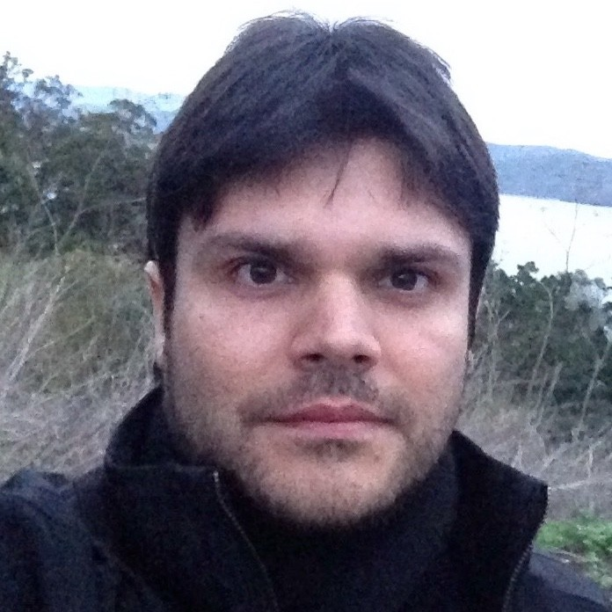

Allan Soares Ramalho¹
Geophysicist (UFF)
M.Sc Student in Marine Geology and Geophysics (UFF)
Kristoffer A.T. Hallam²
Physicist (UFRJ)
M.Sc in Marine Geology and Geophysics (UFF)
Ph.D in Processing, Modeling and Inversion (ON/MCTIC)
Rodrigo Bijani¹
Physicist (UFF)
M.Sc in Geophysics (ON/MCTIC)
Ph.D in Geophysics (ON/MCTIC)

Slide 3
Summary
Introduction
Methods
Results
Conclusions

Slide 4
Introduction

Slide 5
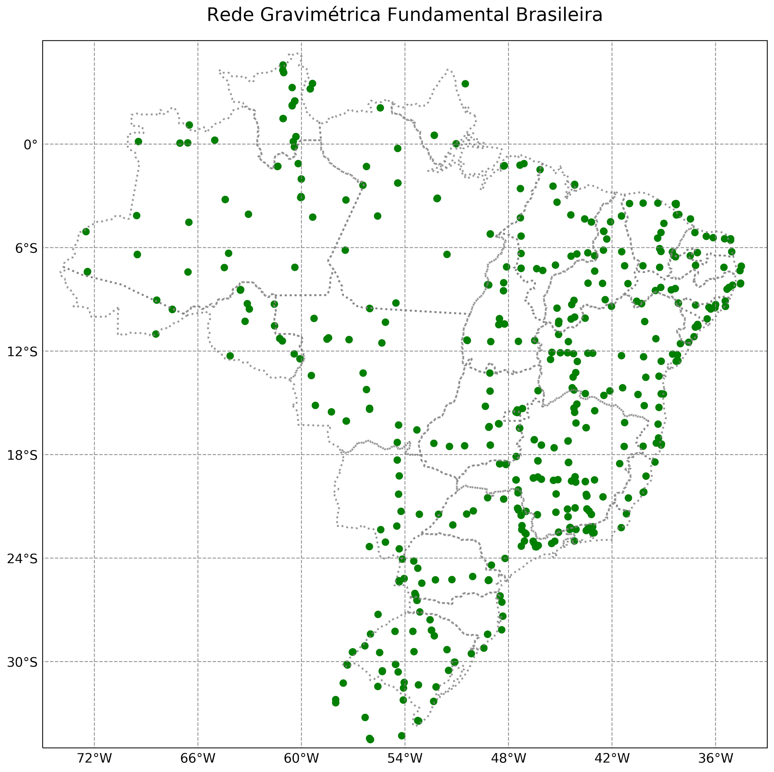
Introduction
Problem:
Unfilled zones
ON RGFB Collection (JÚNIOR, 2018).

Slide 6
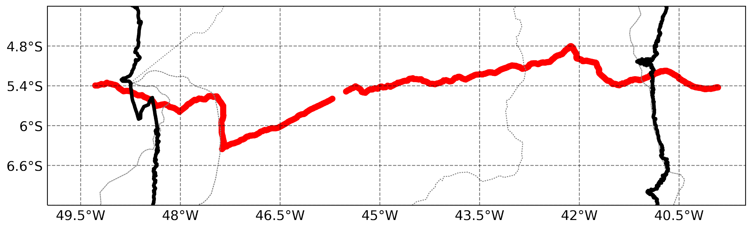
Introduction
Problem:
Unfilled zones
Restricted areas

Slide 7
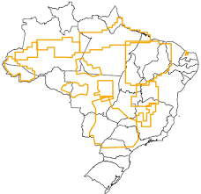


Introduction
Alternative methods
Transported gravimetry
Data coverage
Acquisition speed
Undesirable noises
Operating fee
Aerogravimetry collection at BNDG (ANP, 2015).

Slide 8
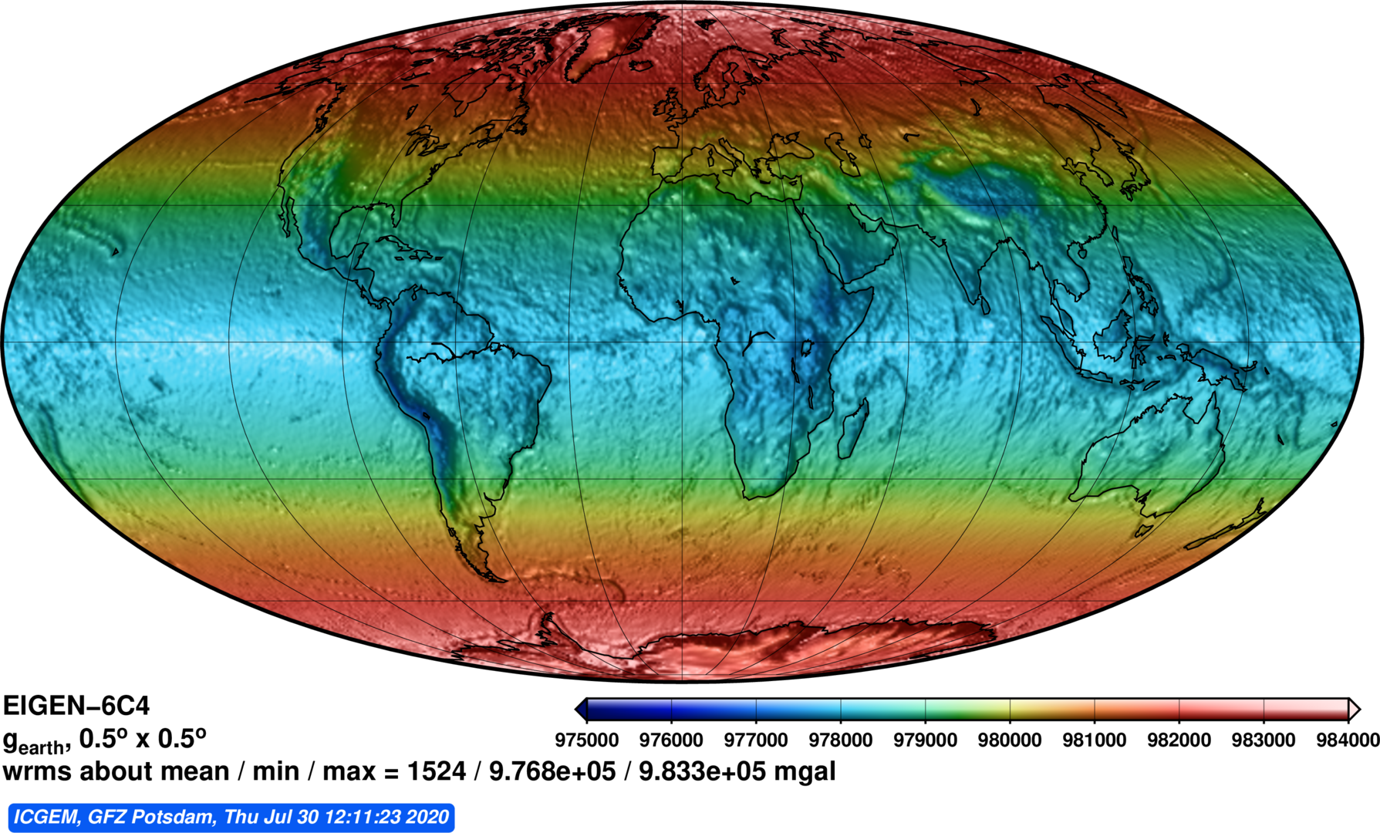
Introduction
Alternative methods
Global Earth
models
Data coverage
Public data
Combined data
Resolution
http://icgem.gfz-potsdam.de/calcgrid
Notes:
Comparar o eigen com o champ, na questão de resoluçao, justificando seu uso

Slide 9
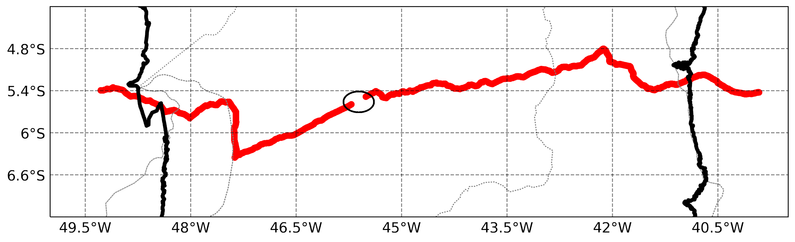
Introduction
Objective
Check the behavior of EIGEN-6C4 in real applications
http://icgem.gfz-potsdam.de/calcgrid
ON RGFB Collection (JÚNIOR, 2018).

Slide 10
Methods

Slide 11
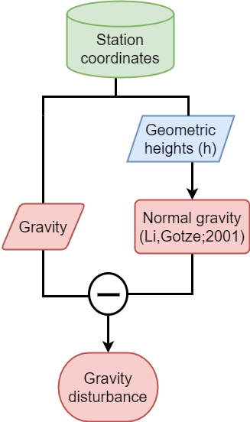
Methods

Slide 12
Methods
Goiás, Brazil
5823 points

Slide 13
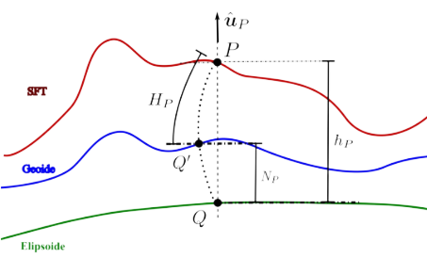
Methods

Slide 14
Methods
Information needed to calculate Normal Gravity
Also used for model analysis

Slide 15

Methods
$$g=∇W_{real}$$

Slide 16

Methods
$$g=∇W_{real}$$
$$γ=∇W_{normal}$$

Slide 17
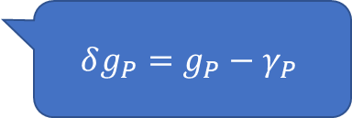
Methods
$$g=∇W_{real}$$
$$γ=∇W_{normal}$$
$$δg_{P}=g_{P}−γ_{P}$$

Slide 18
Results

Slide 19
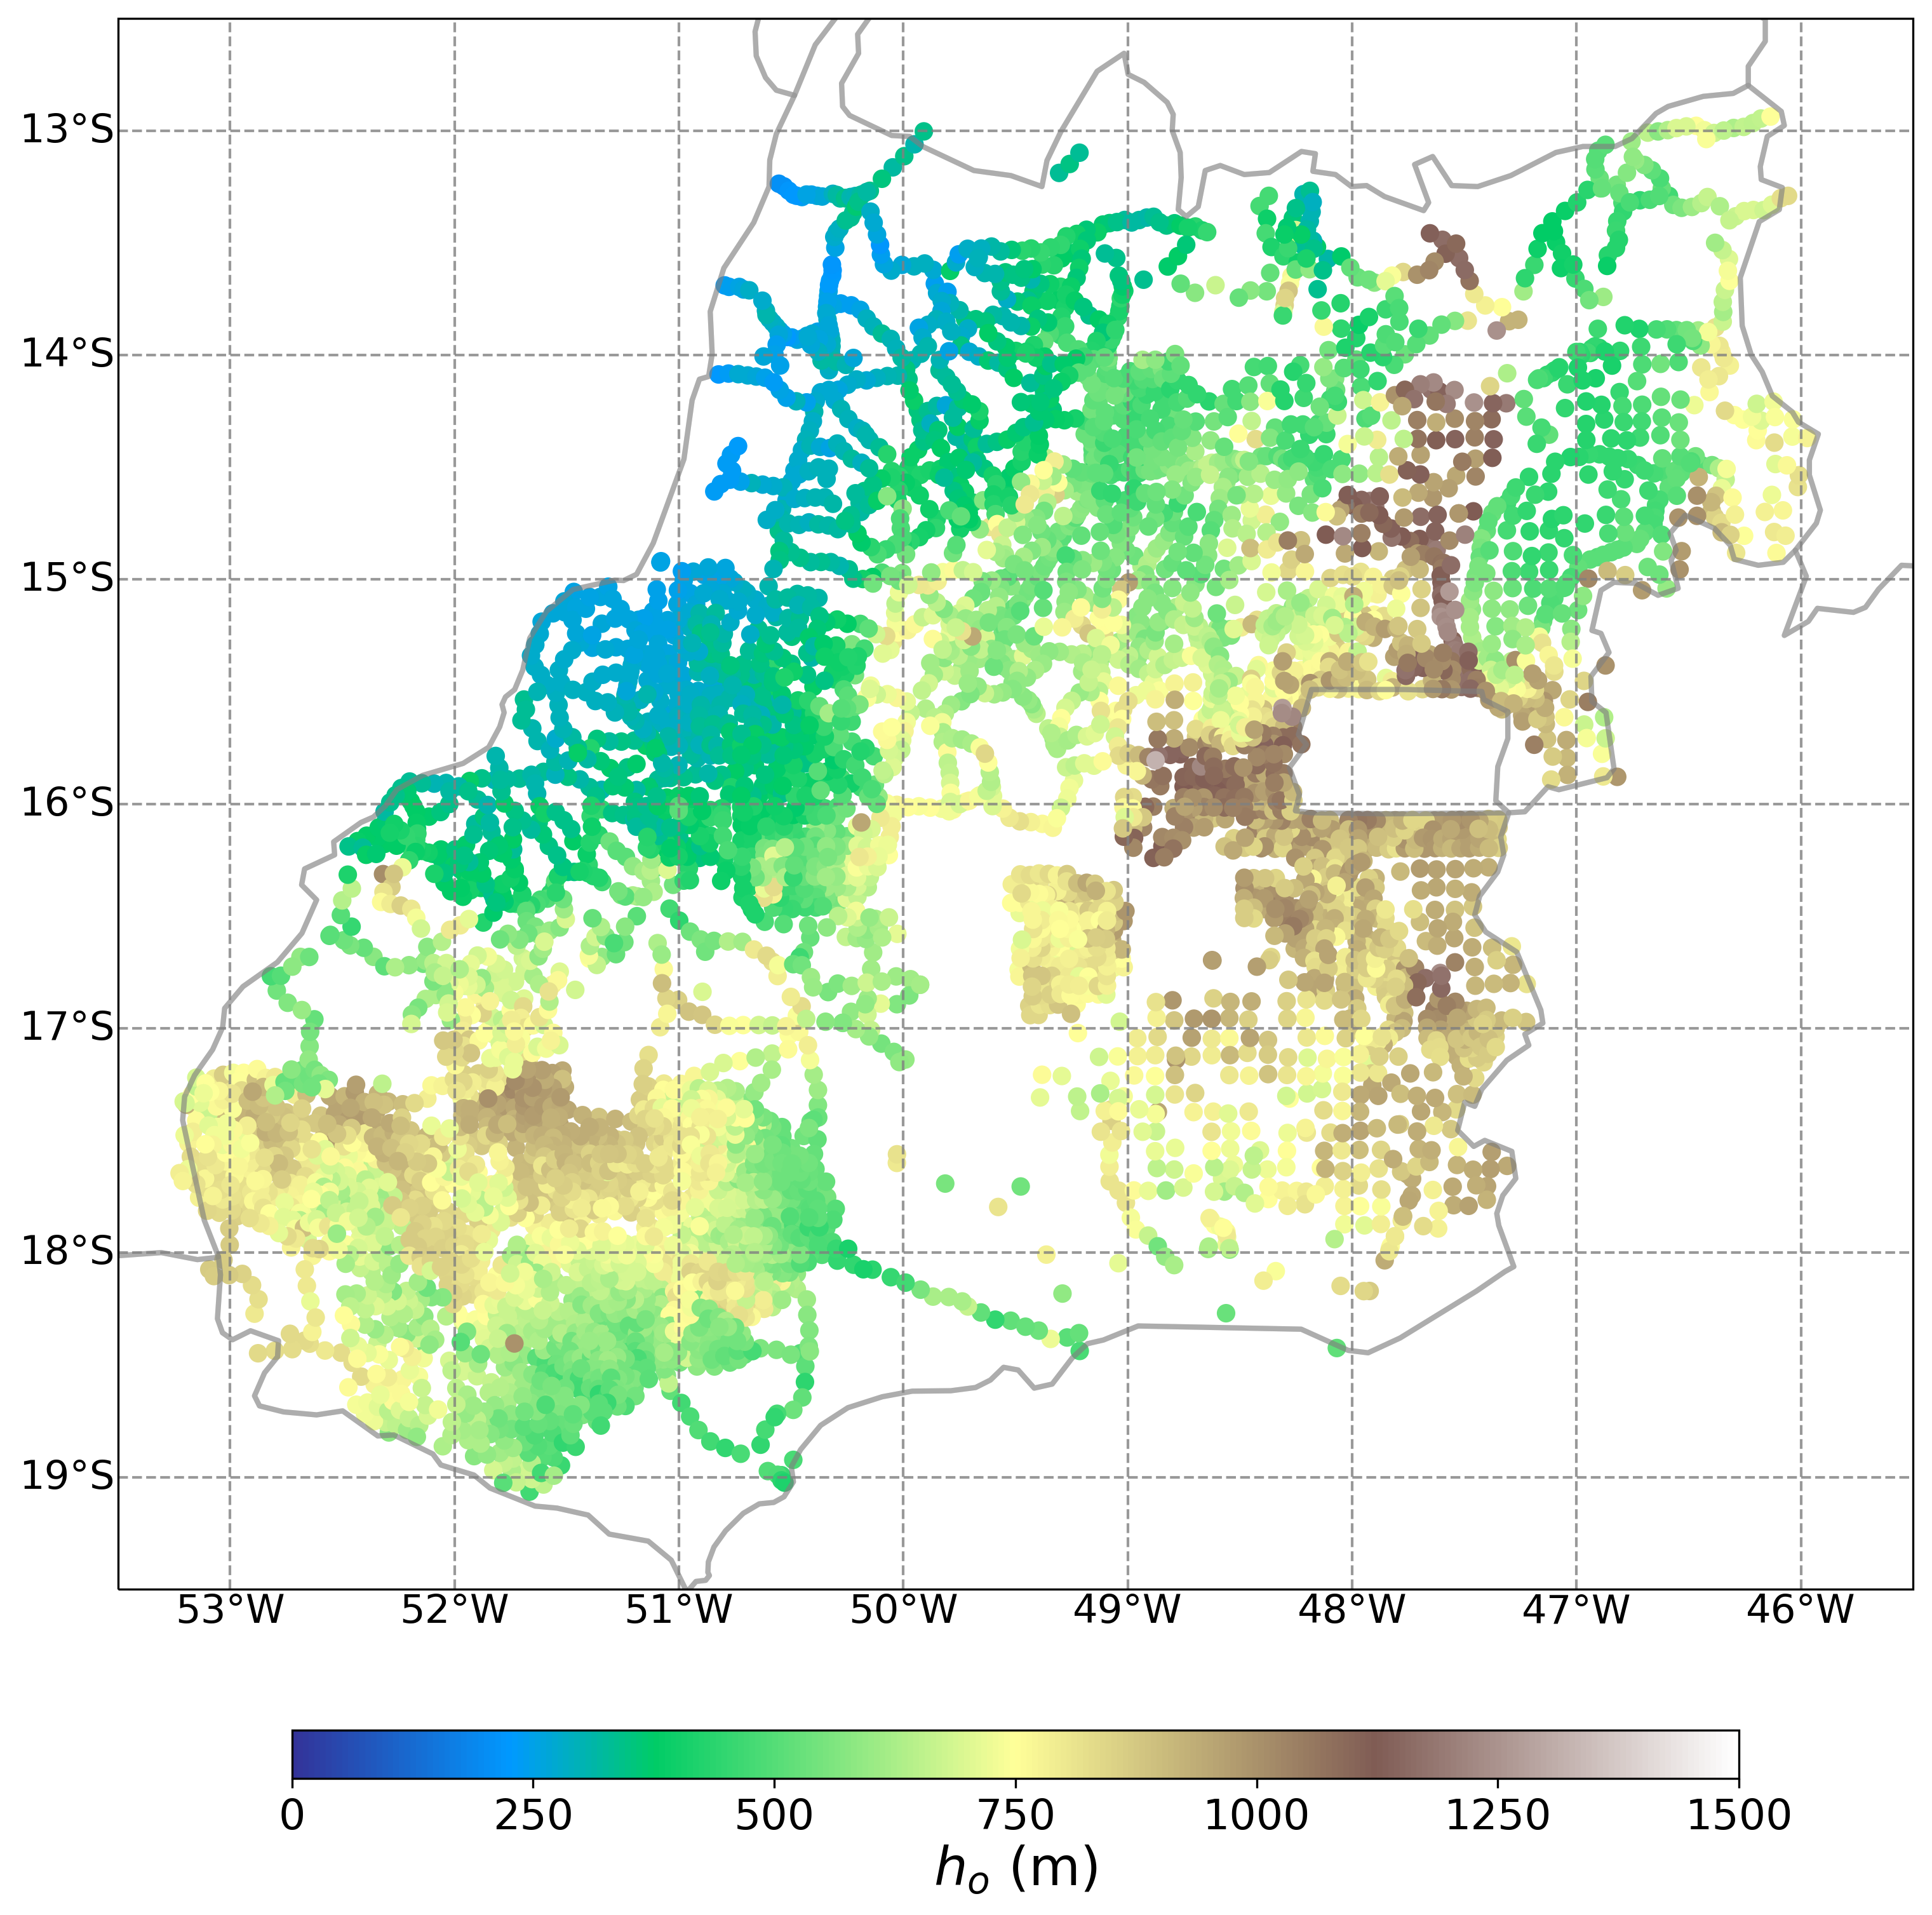
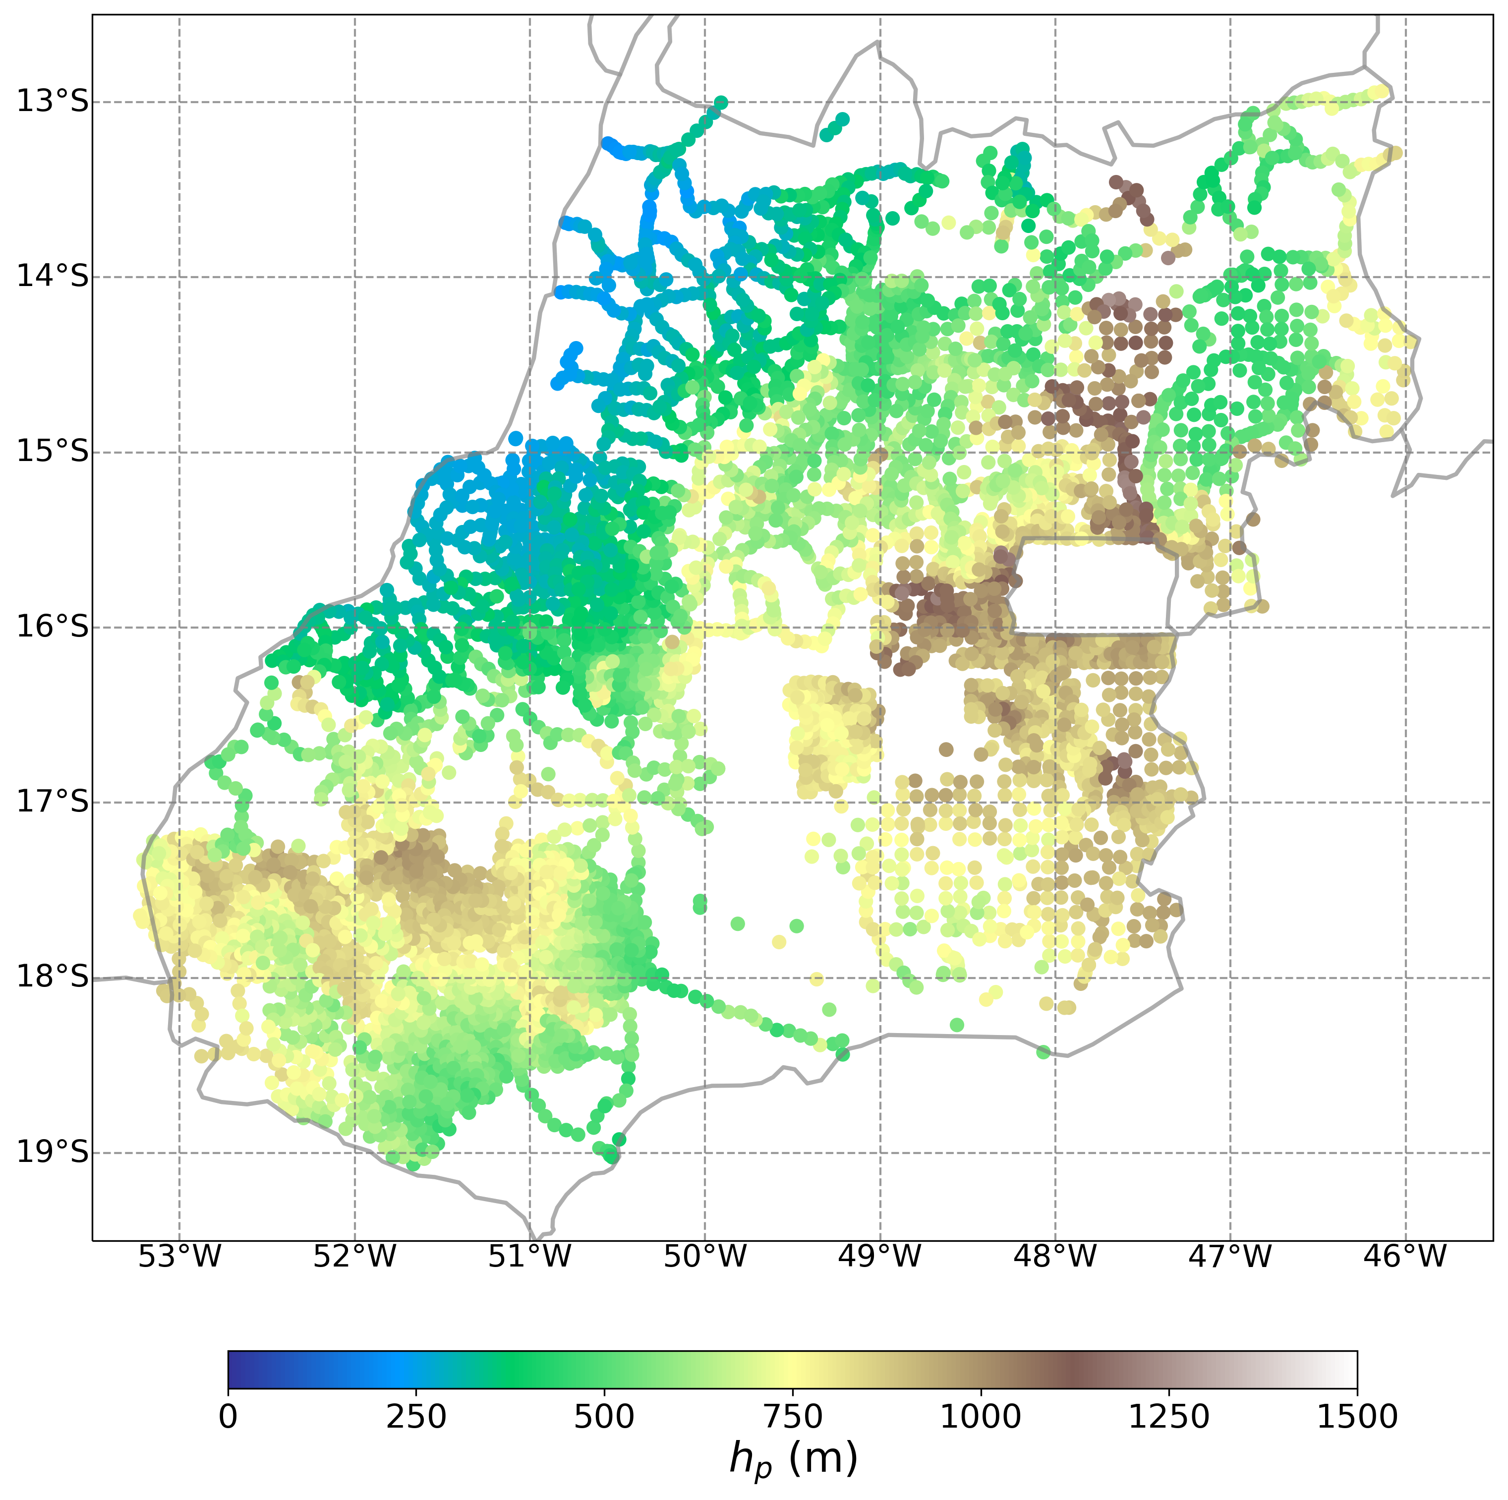
Results
Observed
Predicted

Slide 20
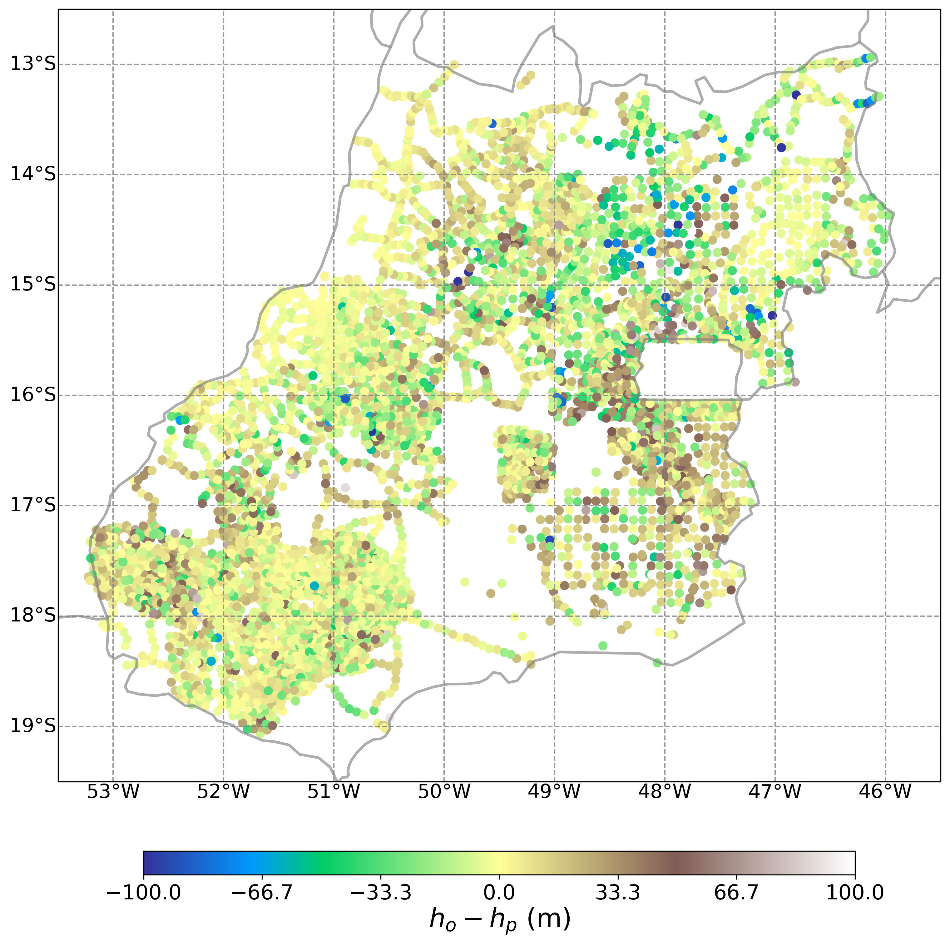
Results
Good overall compliance
Waste mostly close to 0

Slide 21
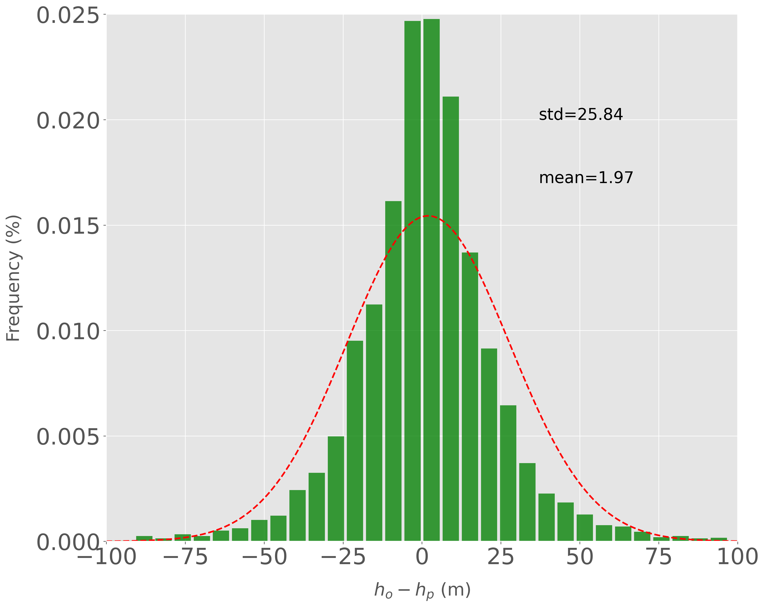
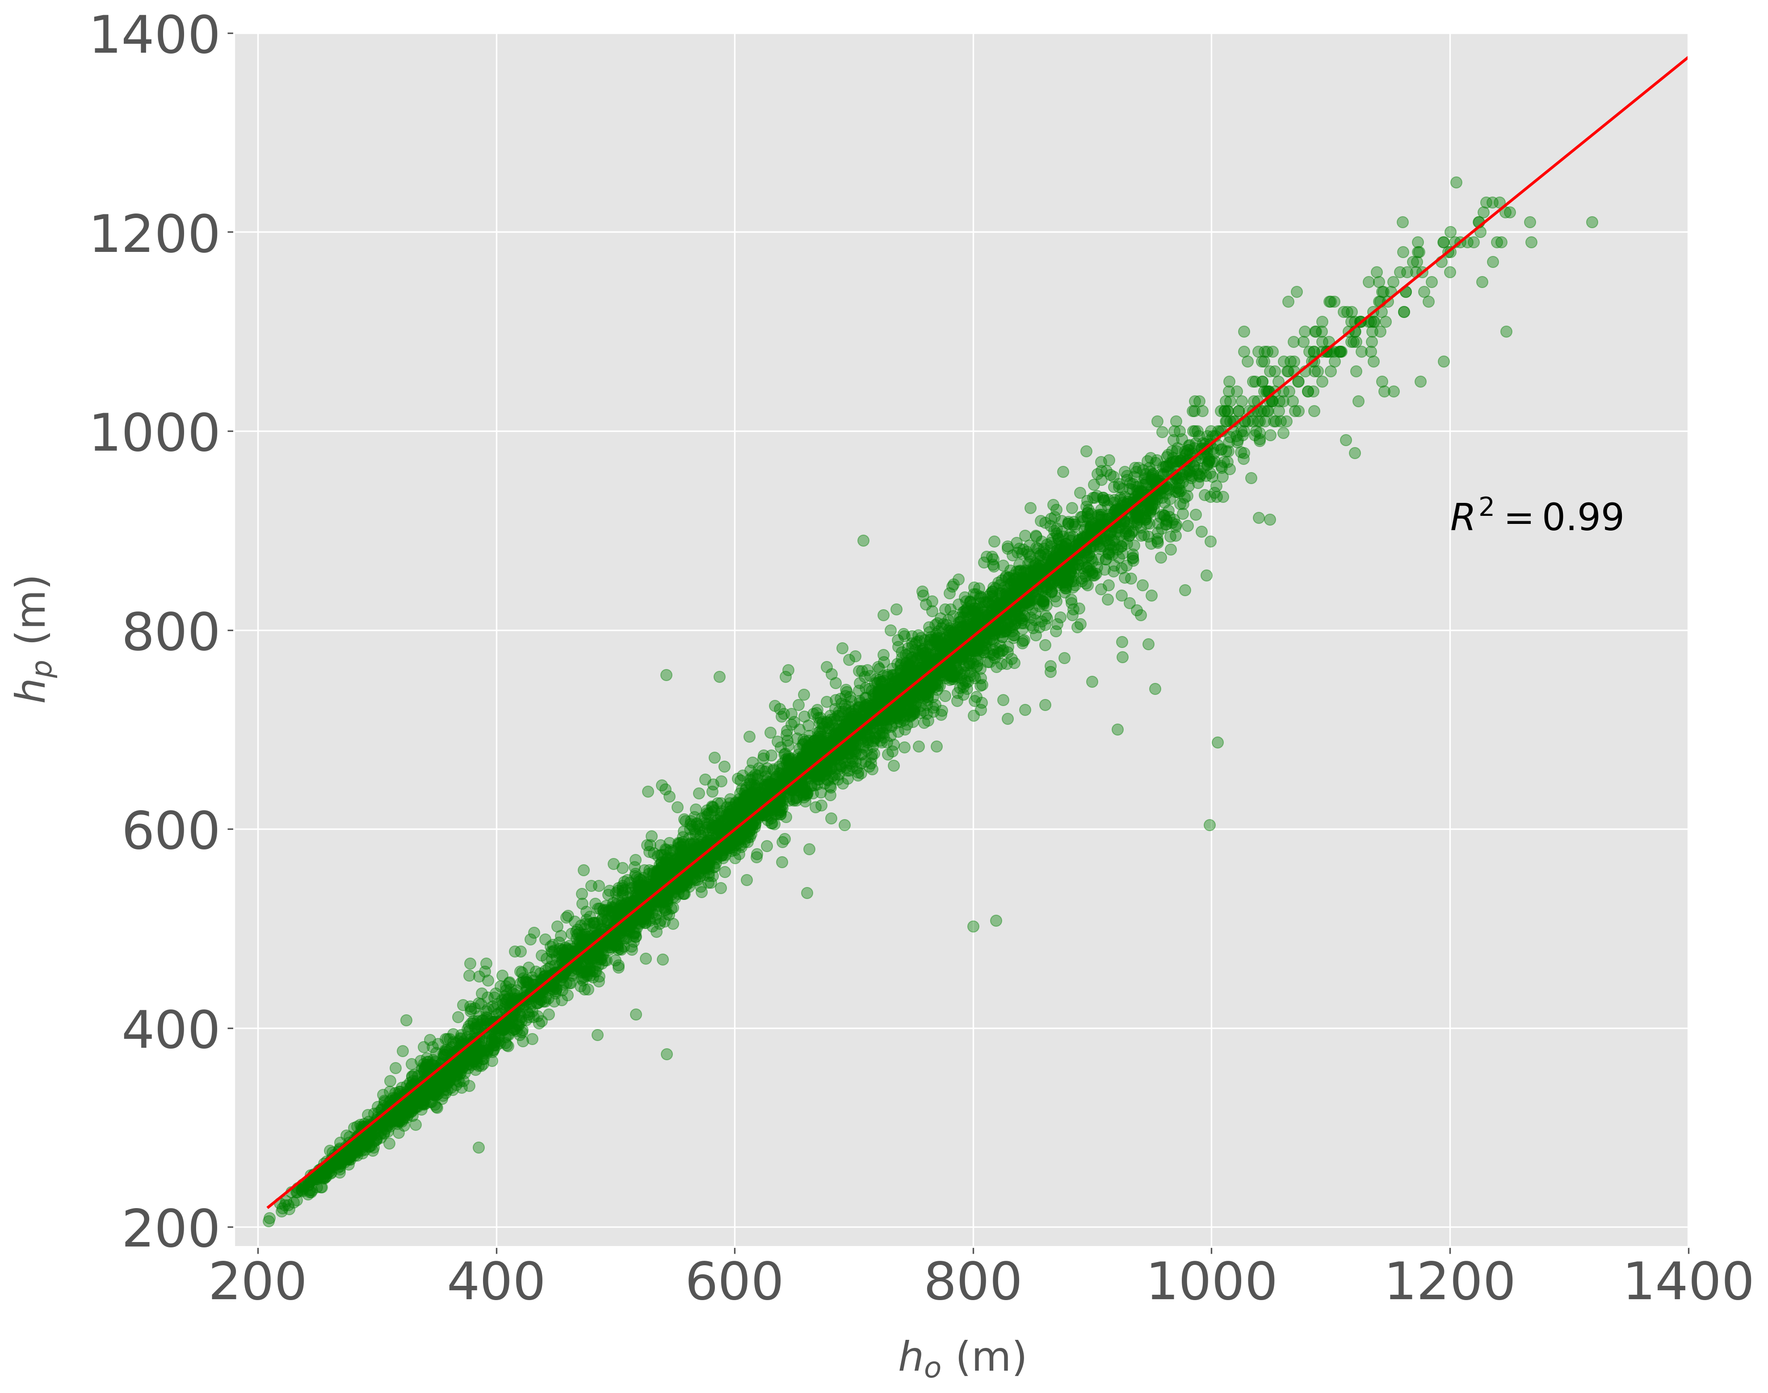
Results
Normal distribution
Mean nearby to 0
Good fit of the model

Slide 22
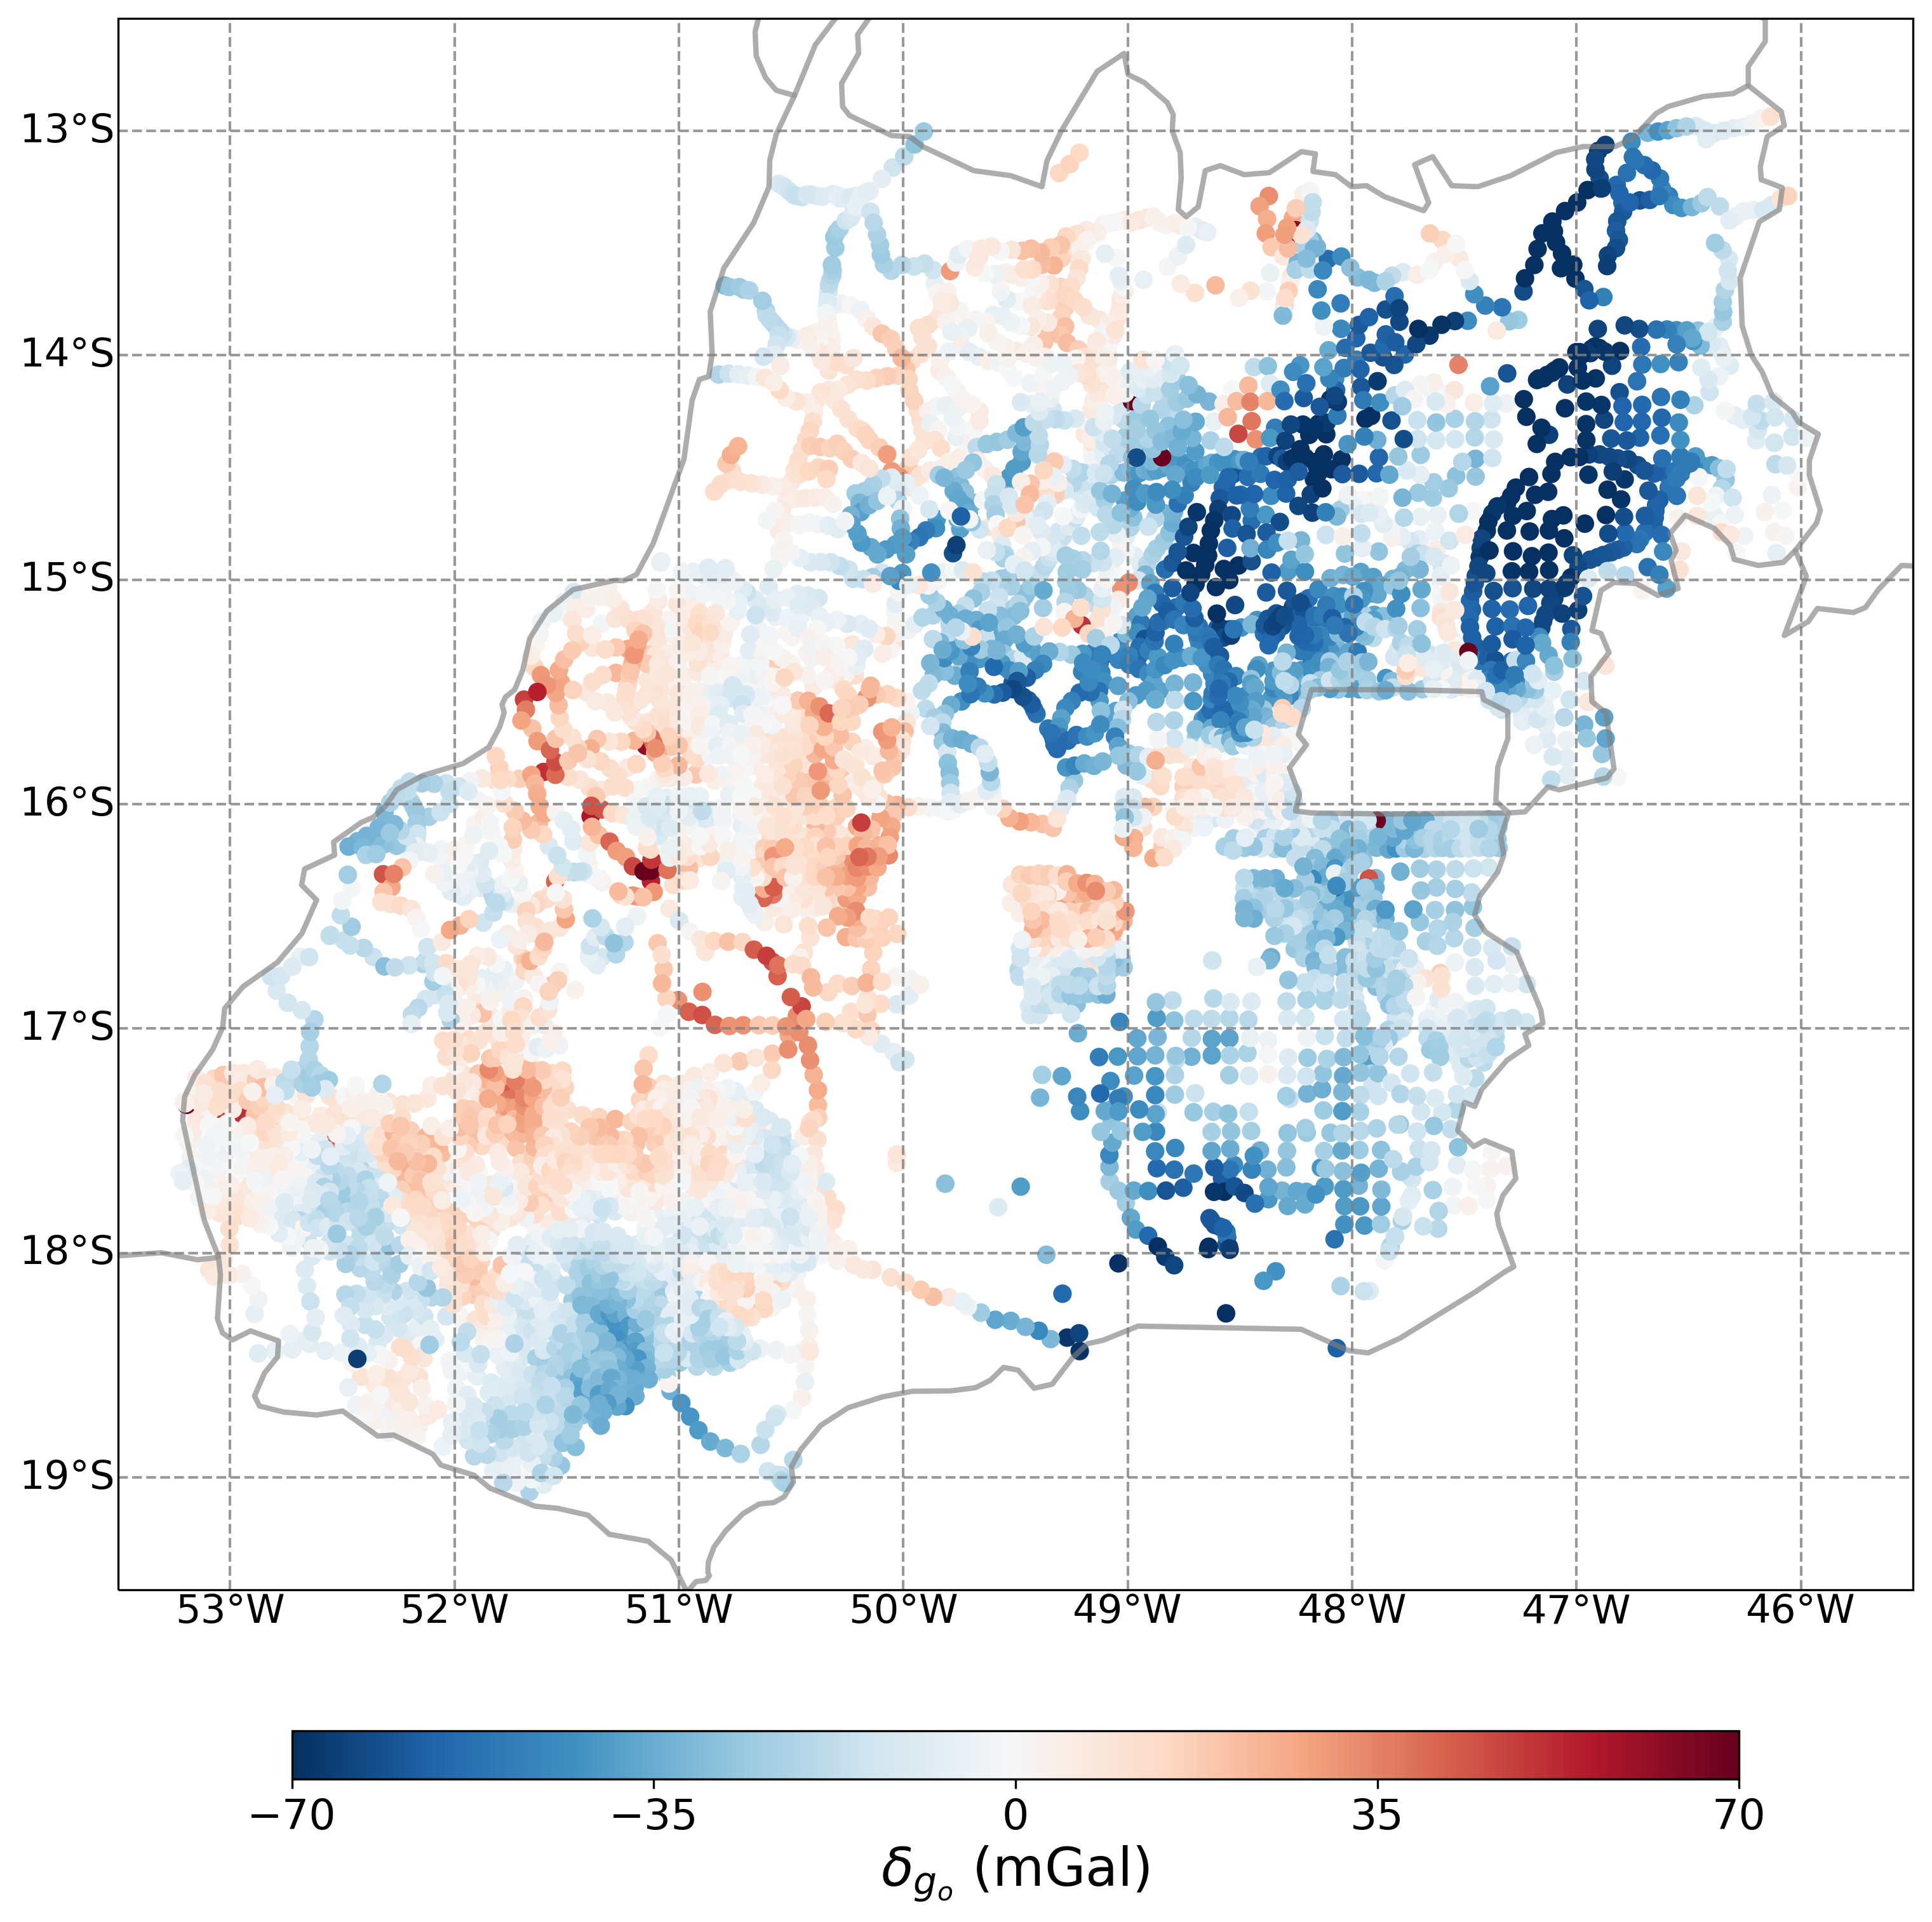
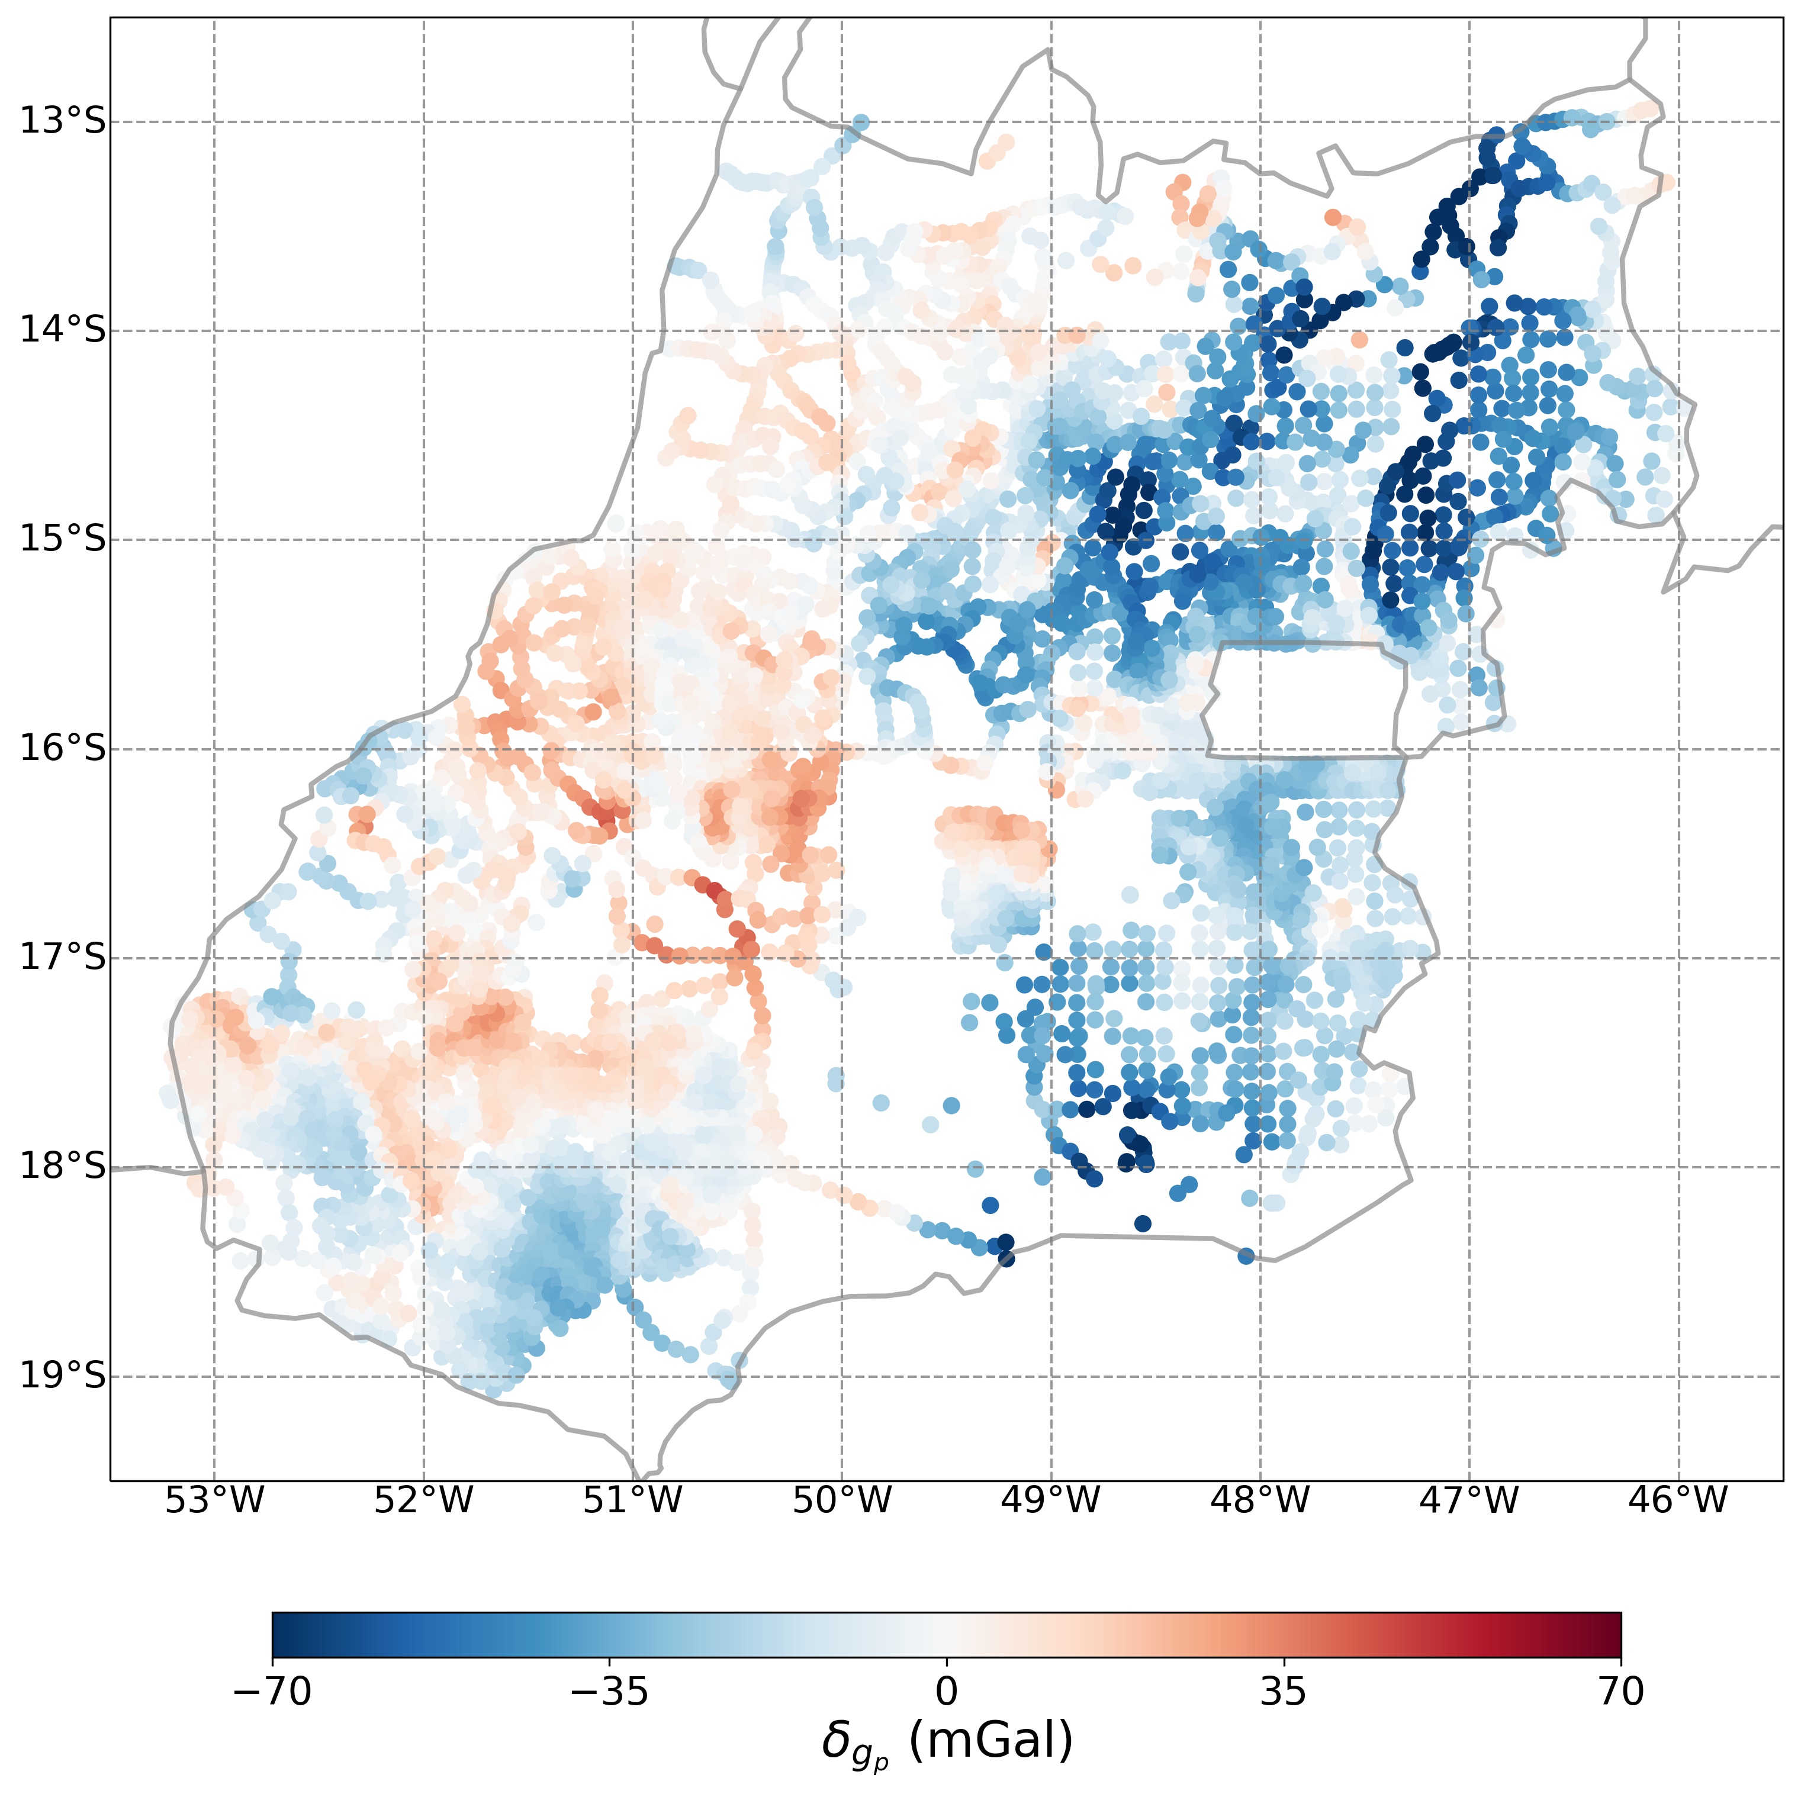
Results
Observed
Predicted

Slide 23
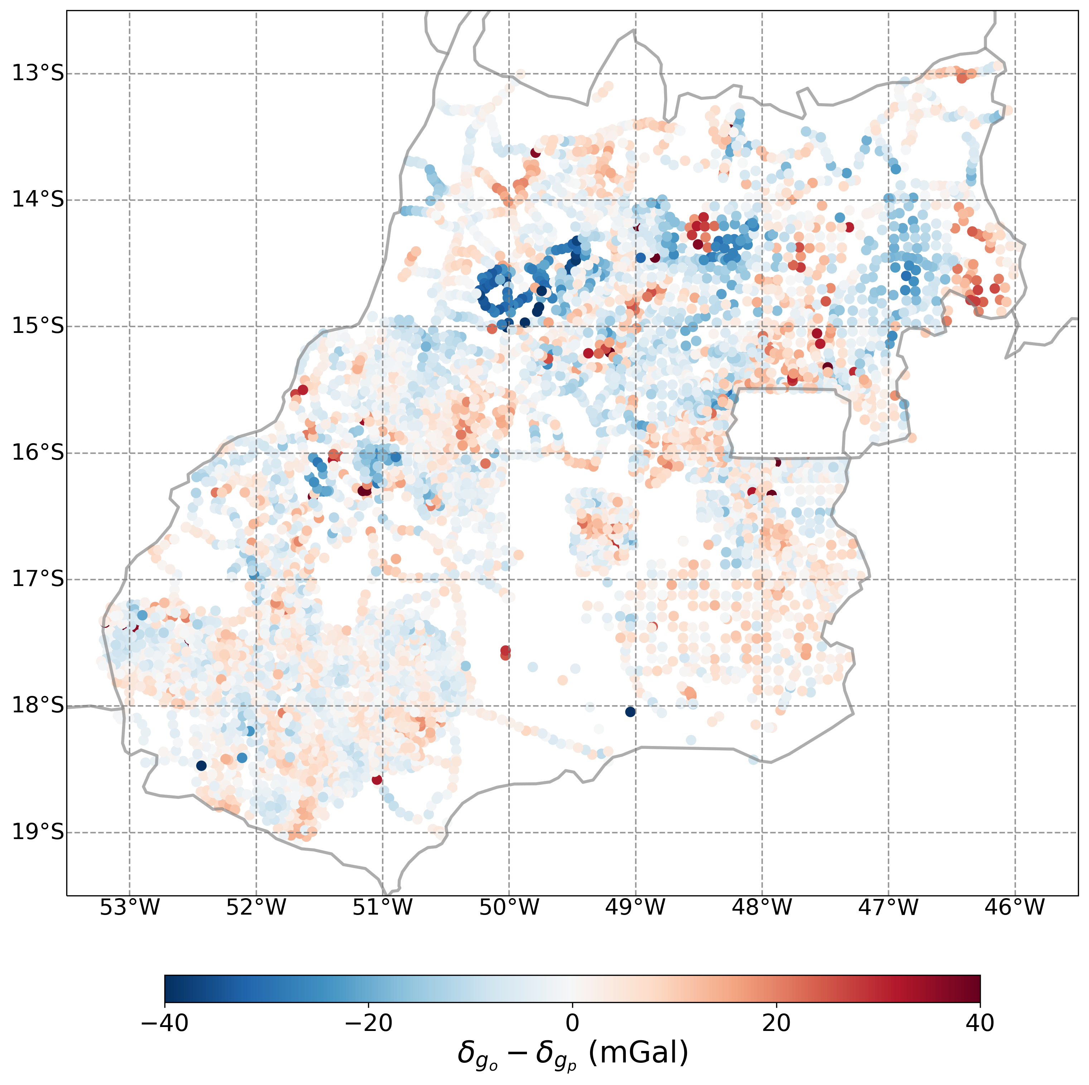
Results
Good overall compliance
Waste mostly close to 0
Few discrepancies

Slide 24
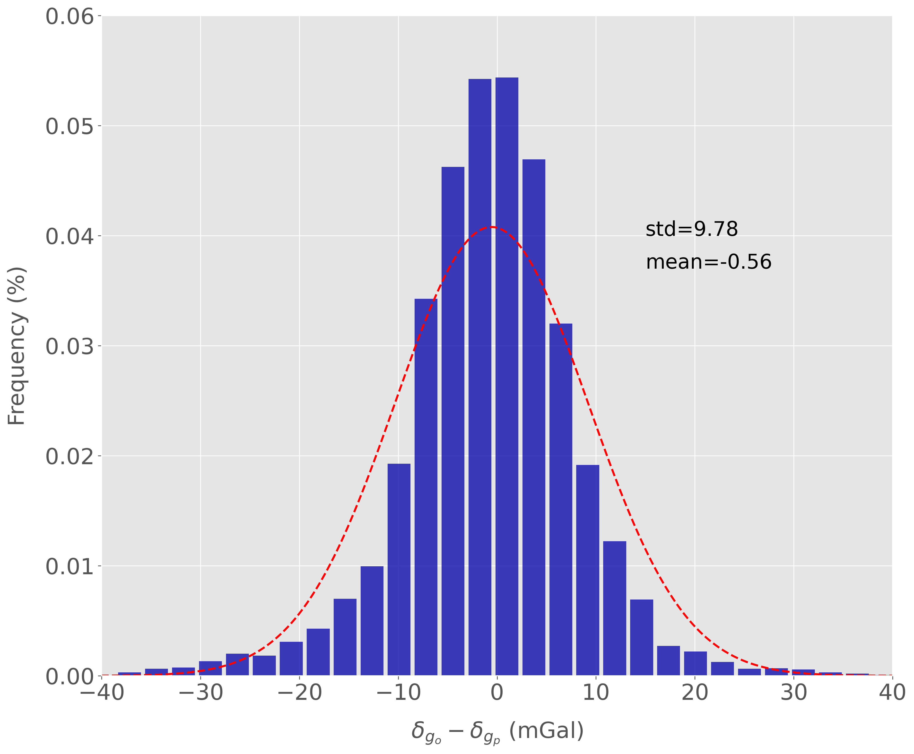
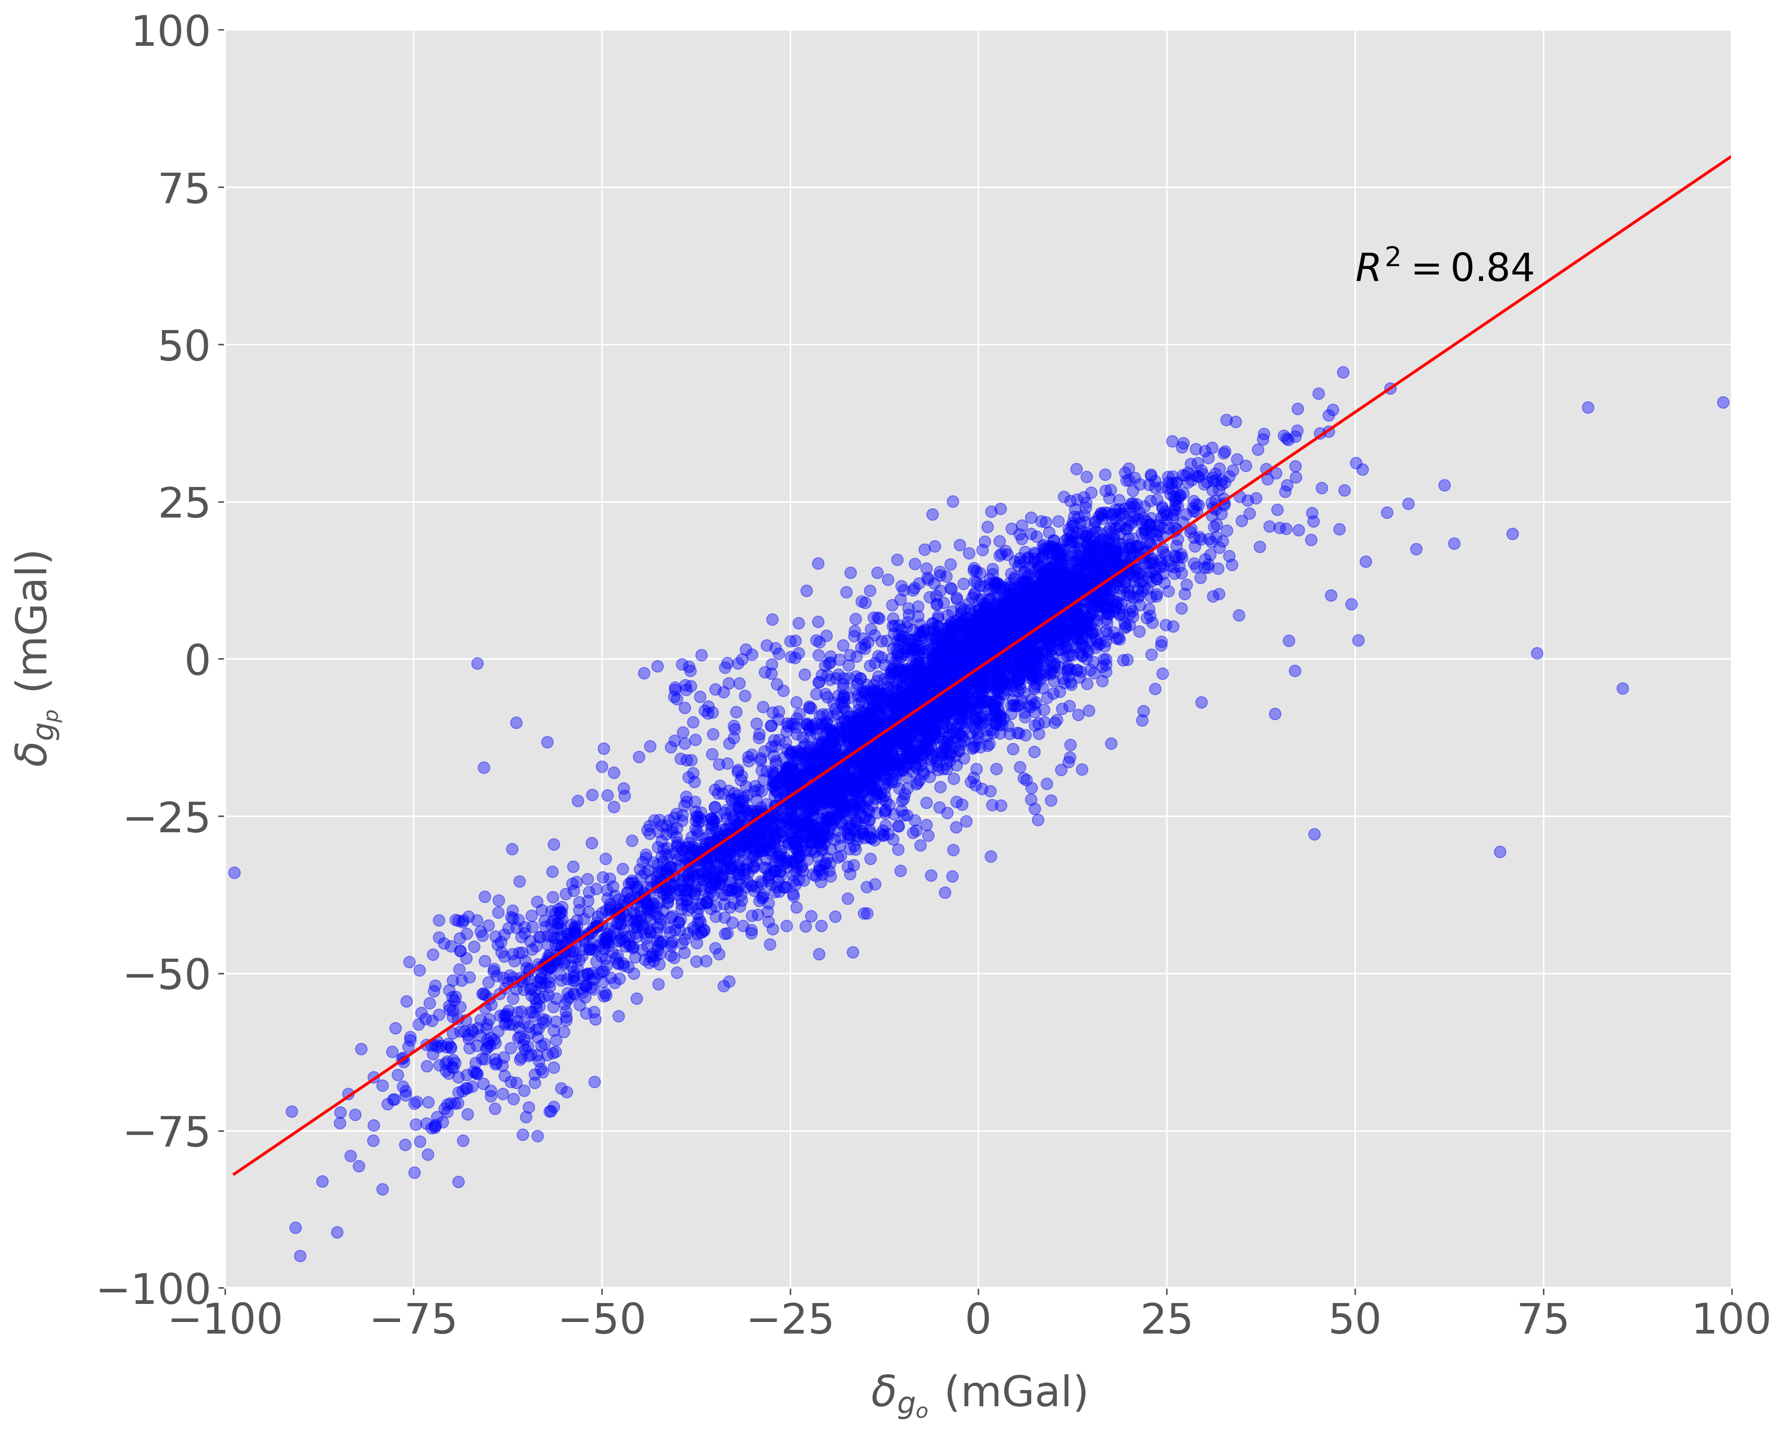
Results
Normal distribution
Mean nearby to 0
Good fit of the model

Slide 25
Conclusions

Slide 26
Conclusions
This work aims to present a comparative study for observed and predict gravity disturbances. Additionally, observed and predict geometrical heights are also considered in this work.
In a general view, the regional trends in both data-sets are represented by the model quite well. However, severe discrepancies in data amplitudes are noted, which is probably related to the truncation of the spherical harmonics expansion of n = 2190.
This study shows that Global Models are very efficient in predicting data with large wavelengths. Statistical analysis comprising histograms and crossplots of both gravity disturbances and geometrical heights endorses the presented discussion.
As a future perspective, we could deal with a more regional gravity survey to verify if the modeled-data amplitudes are better represented. Additionally, other Global Earth Models could also be considered for a broader comparison and verification.

Slide 27


Acknowledgments
We thank the National Observatory and the Fluminense Federal University for providing all the technical resources necessary for the development of this study.

